Slide 1
Lecture 7
Thermal Insulation & Cryostat Basics
J. G. Weisend II

Slide 2
Goals
Introduce conduction, convection & radiation heat transfer as they apply to cryogenics
Describe design techniques to reduce heat transfer into cryogenic devices
Allow the estimating and scaling of heat leaks into cryogenic devices
Discuss the basics of cryostat design
Warning! Not a full description of heat transfer
  Many topics (boiling, detailed convection calculations, complicated geometries in radiation heat transfer etc) won’t be covered
  Should, however, be a good example of how heat transfer theory can be applied to practical problems.

Slide 3
Three Ways to Transfer Heat
Conduction
  Heat transfer through solid material
Convection
  Heat transfer via a moving fluid
    Natural or free convection – motion caused by gravity (i.e. density changes)
    Forced – motion caused by external force such as a pump
Radiation
  Heat transferred by electromagnetic radiation/photons
There is no such thing as a perfect insulator – though we can design systems with very small heat leaks
All matter above 0 K radiate heat
  Remember we can’t get to 0 K – 3rd Law of Thermodynamics though we can get vanishingly close
Heat flows from high temperature to low
  Heat leaks in, cold doesn’t leak out

Slide 4
Conduction Heat Transfer
Fundamental Equation – The Fourier Law in one dimension
If we assume constant cross section we get:
Reduce conduction heat leak by:
  Low conductivity material: make K(T) small
  Reduce cross sectional area: make A small
  Increase length: make L large
  For a given T_{C} make T_{H} smaller: i.e. use intermediate temperature heat intercepts
    You still have heat leak from 300 K to this intermediate temperature but remember Carnot, It’s more thermodynamically efficient to remove heat at higher temperatures

Slide 5
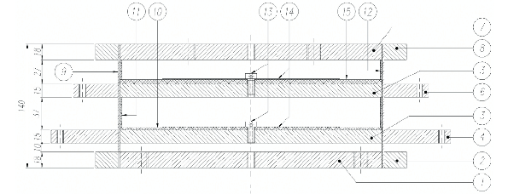
Design Example
ILC Cryomodule Support Post
Courtesy T. Nicol - Fermilab
300 K
70 K
Fiberglass pipe
4 K
2 K
Total Heat Leak (conduction & radiation)
  70 K - 10.5 W
  5 K - 0.9 W
  2 K - 0.03 W
Can support up to 50 kN

Slide 6
Conduction Heat Transfer
Conduction heat leaks may be estimated by the use of Thermal Conductivity Integrals (Lecture 4)

Slide 7
Convection Heat Transfer
Fundamental Equation: Newton’s law of cooling
Q = hA(T_{surface} – T_{fluid})
where h is the heat transfer coefficient and is a function of Re, Pr, geometry etc depending on the situation
In cryogenics we eliminate convection heat leak in cryogenic systems by “simply” eliminating the fluid – vacuum insulation
Using vacuum insulation to create vessels capable of storing cryogenic liquids was first done by James Dewar – who liquefied hydrogen
  Such vessels are frequently called dewars – though not always, more later
  Thermos bottles are a simple example of this approach

Slide 8
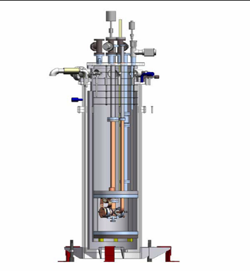
Design Example
Vacuum Insulated Test Cryostat
Contains 3 Vacuum Spaces
  1 between 300 K wall and LN₂ bath
  1 between LN₂ bath and LHe bath
  1 between LHe bath and experiment

Slide 9
Vacuum Insulation
How much vacuum is enough?
  This of course depends on the heat leak requirements but generally we want to be below 10⁻⁵ torr If we maintain this level or better we can generally neglect the convection heat leak for most applications.
    Cryogenic Engineering, Flynn (1997) has a good discussion of calculating heat leak due to residual gas pressure
Cryopumping
  At cryogenic temperatures almost all common gases condense and freeze onto the cold surface. Typically, we’ll see that once surface are cooled to ~ 77 K the isolation vacuum will drop to the 10⁻⁸ torr or better range if the system is leak tight and doesn’t have significant outgassing
  But don’t just start cooling with everything at room pressure
    Heat leak will likely be too high
    Safety hazards due to enrichment of LOX on cold surfaces
    Large amounts of condensed gases in vacuum space can lead to other problems including rapid pressure rise upon warming and possible solid conduction
    Best practice is to be at least 10⁻³ torr before cooling, lower pressures are better but there may be operational tradeoffs

Slide 10
Outgassing and Getters
All material outgas into a vacuum. This can raise the pressure in a sealed vacuum space
Reduce outgassing by:
  Minimize amount of polymers, wire insulation, FRP etc – difficult
  Keep vacuum surfaces as clean as possible. Remove any oil or cutting fluid, wear gloves etc.
Getters: materials inserted into vacuum spaces to remove residual gas at low pressures
In cryogenic systems, getters may be useful in removing residual gas and passively managing small leaks

Slide 11
Outgassing and Getters
3 types of getters
  Adsorbers –gas bonds to surface
    Activated charcoal, silica gel
    Effectiveness increases with decreasing temperature – good for cryogenic systems
  Chemical getters – chemical reaction between material and gas
    Ba & other Alkali metals – not very common in cryogenics
  Solution or absorber getters – gas is absorbed in interstitial space of metals
    Ti, Zr, Th works well with H₂, O₂ and N₂
    Much better at room temperature
    Occasional use in room temperature applications in cryogenic systems

Slide 12

Getters, Cryogenics and Gilligan’s island
It turns out that one of the most common and effective materials used for getters of low pressure He gas is activated charcoal made from coconut husks.
There is a significant amount of this material in the LHC magnet cryostats
The Professor says:
“Lets look for the Higgs!”

Slide 13
Foam & Other Insulation
Methods
Not all cryogenic systems use vacuum insulation
This is particularly true of storage vessels for fluids other than helium
Reasons for using alternatives to vacuum insulation
  Cost
  Weight – Space shuttle main tank
  Required hold time – related to size
  Complex vessel shapes
Some solutions
  Expanded closed or open cell foams
  Rock wool, fiberglass or other porous material
These all require vapor barriers to prevent air from being pulled into the insulation and condensed (can cause both a safety hazard via O₂ enrichment & reduce effectiveness)

Slide 14
Design Example:Complex Foam Insulation
System: LH₂ Tank for 2nd Stage Saturn V
From Cryogenic Engineering, Flynn
Allows helium purging of the insulation
Weight ~ 4.15 kg/m²
Performance: measured effective thermal conductivity (0.86 – 1.1 mW/cm K) at T_{av} = 144 K Note this includes conduction, convection and radiation heat transfer

Slide 15
Radiation Heat Transfer
Frequently the largest source of heat leak to cryogenic systems
Fundamental Equation: Stefan-Boltzmann Law – energy emitted from an ideal black body: E_{b} = σT⁴ where σ = 5.67x10⁻⁸ W/m²K⁴
  Real world Assumptions:
    Emissivity (ε) << 1 and independent of wavelength (grey body)
    Two parallel infinite plates: Radiative heat flux (W/m²)
    Eq. A
    Frequently in cryogenic systems ε₁ ~ ε₂ << 1 then Eq. A becomes:
    Eq. B

Slide 16
Radiation Heat Transfer
    Two long concentric cylinders or concentric spheres (1 represents the inner cylinder): the radiative heat flux (W/m²) on the inner cylinder is
    Eq. C
    Note as is frequently the case in cryogenics, if the spacing between the cylinders is small compared to the inner radius (i.e. A₁ ~ A₂ ) Eq. C becomes Eq. A

Slide 17
Radiation Heat Transfer
Looking at Eq. A, How do we reduce
the radiation heat transfer?
We could reduce the emissivity (ε)
  This is done in some cases; using either
  reflective tape or silver plating
  Better below 77 K
  It’s also part of MLI systems (see below)
  We have to consider tarnishing
  May be labor intensive
From Helium Cryogenics – S. W. Van Sciver

Slide 18
Radiation Heat Transfer
Another way to reduce radiation heat transfer is to install intermediate actively cooled radiation shields that operate at a temperature between 300 K and the lowest cryogenic temperature. This has several advantages.
  It greatly reduces the heat load to the lowest temperature level
    Assume parallel plates with ε = 0.2
    then from Eq. B q ( 300 K – 4.2 K ) = 46 W/m² while q (77 – 4.2) = 0.2 W/m²
  It allows heat interception at higher temperatures & thus better Carnot efficiency
  Such an actively cooled shield provides a convenient heat intercept for supports, wires etc to reduce conduction heat leak.
Shields may be cooled by
  Liquid baths ( LN₂)
  Vapor boil off from stored liquid – common in LHe storage dewars
  Cooling flows from refrigeration plants
  Conductive cooling via small cryocoolers

Slide 19
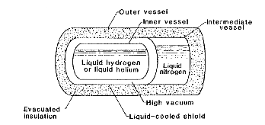
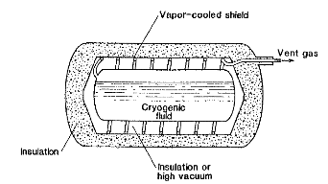
Examples of Cooled
Radiation Shields
LN₂ bath surrounds inner LHe or LH₂ bath
Baths are separated by a vacuum insulation space
Shield is cooled by boil off gas from stored cryogen
  Spacing of cooling tubes on shield may be calculated by: ΔT = qL²/2kt
    ΔT = max allowable temperature difference between any point on shield and tube
    q = heat flux on shield
    k = shield thermal conductivity
    L = ½ max tube spacing
    t = shield thickness
From Cryogenic Engineering, Flynn

Slide 20
Thermal Radiation Shields
Uncooled thermal radiation shields placed in a vacuum space between the warm & cold surfaces also help reduce the thermal radiation heat leak
It can be shown (with the grey approximation and equal emissivities) that with N shields thermal radiation heat transfer is given by:
This is the motivation behind Multilayer Insulation

Slide 21
MultiLayer Insulation
Also referred to as superinsulation
Used in the vacuum space of many cryostats (10⁻⁵ torr or better for best performance)
Consists of highly reflective thin sheets with poor thermal contact between sheets.
  Made of aluminized Mylar ( or less frequently Kapton)
  May include separate non conducting mesh
  May use Mylar aluminized on only one side and crinkled to allow only point contacts between sheets
  Frequently perforated to allow for better pumping
Can be made up into blankets for ease of installation
Don’t pack MLI too tightly. Optimal value is ~ 20 layers / inch
Great care must be taken with seams, penetrations and ends.
  Problems with these can dominate the heat leak

Slide 22
MLI

Slide 23
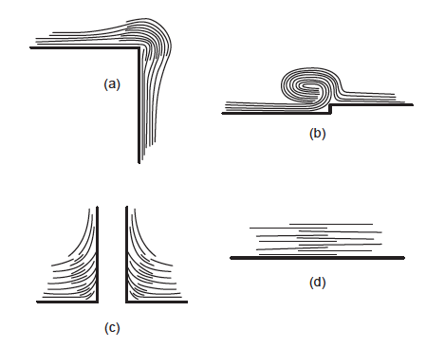
Examples of Proper MLI Installation
From “Cryogenic Engineering” in Wiley Mechanical Engineer’s Handbook

Slide 24
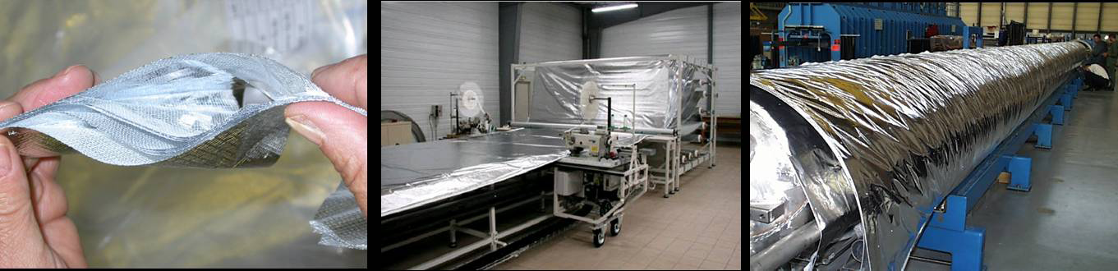
MLI Example from LHC cryostats
“SERIES-PRODUCED HELIUM II CRYOSTATS
FOR THE LHC MAGNETS: TECHNICAL CHOICES,
INDUSTRIALISATION, COSTS”
A. Poncet and V. Parma
Adv. Cryo. Engr. Vol 53

Slide 25
Porous Insulation
Radiation heat transfer may also be reduced by filling the vacuum space between 300 K and cryogenic temperatures with other materials that are low conductivity and block line of sight
Such materials include:
  Glass beads or microspheres
  Perlite powder (made from a volcanic rock)
  Opaciated powders – copper or other metallic flakes mixed in with other powders to further reduce radiant heat transfer
  Aerogel
Advantages:
  Cheaper
  Easier to install in complex shapes
  Better performance than MLI in poor or no vacuum
Frequently used in large storage and transport dewars

Slide 26
Porous Insulation
The total heat transfer through porous insulation between 2 spheres may be estimated by:
Where
  t = thickness of Insulation
  = the mean thermal conductivity
  1 = inner vessel and 2 = outer vessel
Mean thermal conductivities may be found in references such as
Cryogenic Engineering by Flynn

Slide 27
Comparison of Thermal
Insulation Approaches
( 6 inch thick insulation in all cases)
 | Total Heat Flux ( W/m²)
Type of Insulation | 300 K to 77 K | 77 K to 20 K
Polystyrene Foam (2 lb/ft³) | 48.3 | 5.6
Gas Filled Perlite powder (5 – 6 lb/ft³ filled with He) | 184.3 | 21.8
Perlite powder in vacuum (5 – 6 lb/ft³) | 1.6 | 0.07
High Vacuum (10⁻⁶ torr ε = 0.02) | 9 | 0.04
Opacified powder (Cu flakes in Santocel) | 0.3 | -
MLI | 0.03 | 0.007
Increasing Cost
& Complexity
Note better performance of evacuated Perlite over high vacuum between 300 K & 77 K
From Cryogenic Systems – Barron
For rough estimates only

Slide 28
Cryostat Design
What is a cryostat?
  A device or system for maintaining objects at cryogenic temperatures.
Cryostats which contain superconducting RF systems are traditionally called cryomodules (term originally coined by Jlab)
Cryostats whose principal function is to store cryogenic fluids are frequently called Dewars. Named after the inventor of the vacuum flask and the first person to liquefy hydrogen

Slide 29
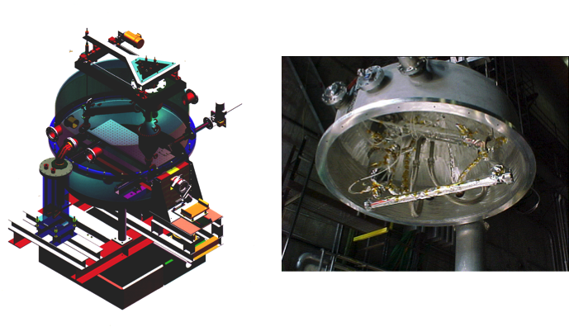
E158 LH₂ Target Cryostat

Slide 30
Cryostat Design
Cryostats are one of the technical building blocks of cryogenics
Cryostat design involves many subtopics:
  Development of requirements – covered here
  Materials selection – already covered
  Thermal insulation - already covered
  Support systems – covered here
  Safety – covered in a future lecture
  Instrumentation – covered in a future lecture
One of the best ways to learn about cryostat design is through examples (see next talk) Also:
  Cryostat Design J.G. Weisend II (Ed) Springer (2016)
There are many different types of cryostats with differing requirements
  The basic principles of cryostat design remain the same
  Before we can do anything else we have to define our requirements

Slide 31
Cryostat Requirements
Maximum allowable heat leak at various temperature levels
  This may be driven by the number of cryostats to be built as well as by the impact of large dynamic heat loads (SCRF or target cryostats)
Alignment and vibration requirements
  Impact of thermal cycles
  Need to adjust alignment when cold or under vacuum?
  Alignment tolerances can be quite tight (TESLA :
  +/- 0.5 mm for cavities and +/- 0.3 mm for SC magnets)
Number of feed throughs for power, instrumentation, cryogenic fluid flows, external manipulators

Slide 32
Cryostat Requirements
Safety requirements (relief valves/burst discs)
  Design safety in from the start. Not as an add on
Size and weight
  Particularly important in space systems
Instrumentation required
  Difference between prototype and mass production
Ease of access to cryostat components
Existing code requirements (e.g. TUV or ASME)
Need, if any, for optical windows
Presence of ionizing radiation

Slide 33
Cryostat Requirements
Expected cryostat life time
Will this be a one of a kind device or something to be mass produced?
Schedule and Cost
  This should be considered from the beginning
  All Design is Compromise

Slide 34
Structural Supports
Solution is highly dependent on cryostat requirements
Choose materials carefully
  Acceptable for cryogenic temperatures
  Low heat leak
Don’t over constrain supports: allow for thermal contraction
Does solution meet alignment and vibration requirements?
Must alignment be changed while cold?

Slide 35
Structural Support Example #1
ILC Cryostat
support
FRP support between 300 K and Cryo temps
Cavity assemblies tied to 300 mm pipe backbone
All other connections to 300 K have flex line or bellows in line
Meets alignment specs
2.2 K forward
2 K return
4.5 K forward
80 K return
40 K forward
300 mm
4.5 K return
cool down/
warmup
2 K 2-phase
cavity
coupler

Slide 36
Structural Support Example #2
JLab 12 GeV Upgrade Cryomodule
All components are tied to space frame which rolls into vacuum vessel
Connections to 300 K done via flex lines and bellows
Same approach taken in ESS elliptical cavity cryomodules

Slide 37
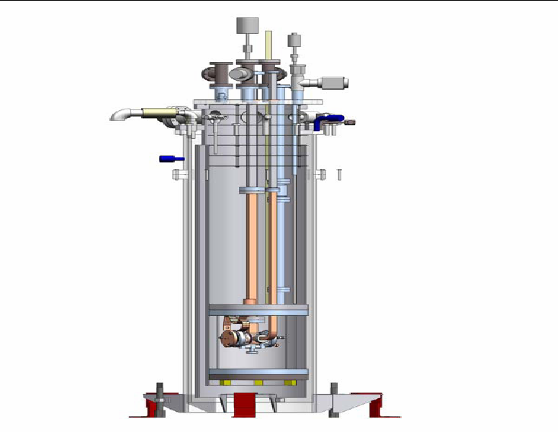
Structural Support Example #3
Simple Top Load Cryostat
Very common for test cryostats
Everything hangs from 300 K top flange
Connections made via low conductivity piping and supports
Everything “contracts up”
Allows easy removal and change of cryostat components
Useful when precise alignment not an issue

Slide 38
Tips for Successful Cryostat Design
    Define and prioritize requirements first. Optimize the cryostat design based on these priorities.
    Design in safety features from the start of the project.
    Only use materials shown to be appropriate for cryogenic temperatures.
    Review literature & learn from previous efforts. Take advantage of existing codes and standards if possible.
    Use tested commercial solutions whenever possible.
    Intercept heat at higher intermediate temperatures.
    Allow for the effect of thermal contraction on cryostat alignment and design. Do not over constrain the movement of cryostat components as they cool.
    Avoid feed throughs & demountable seals at cryogenic temperatures.
    Be sure to properly heat sink temperature sensor wires to ensure reduced heat leak and an accurate reading.
Notes:
38

Slide 39
Tips for Successful Cryostat Design
    Install sensors such a pressure transducers and flow meters at room temperature when possible.
    Analyze the design for possible thermoacoustic oscillations
    Conduct design reviews. These should include experts not directly involved in the design under review. Ideally, there should be at least reviews at the preliminary or conceptual level and again once the detailed design is complete. Safety should be a part of these reviews or separate safety reviews should be held.
    Conduct prototype tests when required. Leave enough time in the design process to benefit from the results of such tests.
    In cases where a large number of cryostats are to be produced, carry out series testing of the production cryostats in addition to any prototype testing. Allow sufficient resources (time, facilities, funding) in the project plan to accomplish these tests.
Notes:
39

